Slide 1

Clinic Management System with Disease Prediction and Appointment Booking
Name: Saurabh Mapari
Exam. No:M240501015
Under the Guidance of
Guide Name:Prof R.S.Paswan
Department of Computer Engineering
SCTR’s Pune Institute of Computer Technology, Pune

Slide 2
Contents
Introduction
Problem Statement & Objectives
Existing vs Proposed System
System Architecture
System Workflow
Module-wise Explanation
Dataset Description
Methodology
Model Comparison
System Implementation
Database Design
Technologies Used
System UI Screens
Future Scope
Conclusion
References

Slide 3
Introduction
The Clinic Management System with Disease Prediction is a full-stack healthcare application designed to automate hospital operations and assist in preliminary disease identification using machine learning.
Traditional clinic systems often rely on manual processes, leading to inefficient appointment scheduling, poor doctor availability management, and lack of intelligent diagnostic support.
The system supports these roles:
Patient – Disease prediction & appointment booking
Clinic Staff/Admin – Doctor & slot management
Secure backend architecture using Spring Boot
Relational database design using MySQL, JPA & Hibernate
Naive Bayes-based disease prediction model

Slide 4
Problem Statement and Objectives
Problem Statement
Many clinics still manage appointments and doctor schedules manually. This can cause:
Delays in booking appointments
Poor management of doctor time slots
Difficulty in maintaining patient records
There is a need for a smart and secure system that manages clinic operations and also helps in basic disease prediction.
Objectives
Obj 1:To develop a Clinic Management System with two roles: Patient and Admin.
Obj 2:To allow patients to book appointments easily.
Obj 3: To help hospitals manage doctors and time slots.
Obj 4: To predict diseases using the Naïve Bayes algorithm based on selected symptoms.

Slide 5
Existing vs Proposed System
Existing System | Proposed System
Manual appointment booking | Online appointment booking
No disease prediction support | AI-based disease prediction (Naive Bayes)
Time-consuming process | Fast and efficient system
Poor doctor availability management | Smart time slot management
No integration between diagnosis and booking | Integrated system (Prediction + Booking)
Higher chances of human errors | Reduced errors through automation
Limited accessibility | Accessible anytime via web system
No role-based security | Secure role-based access (Patient, Admin)

Slide 6
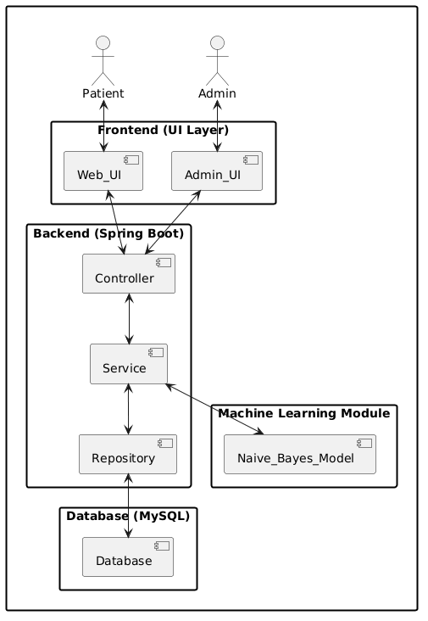
System Architecture diagram

Slide 7
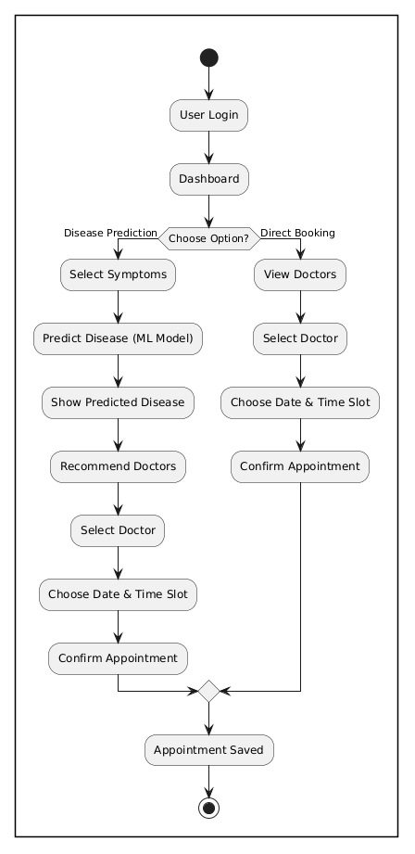
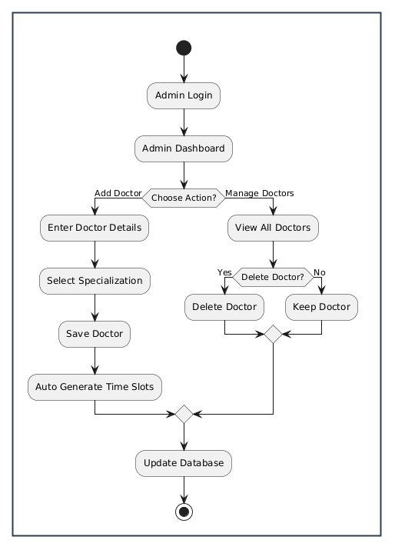
System Workflow

Slide 8
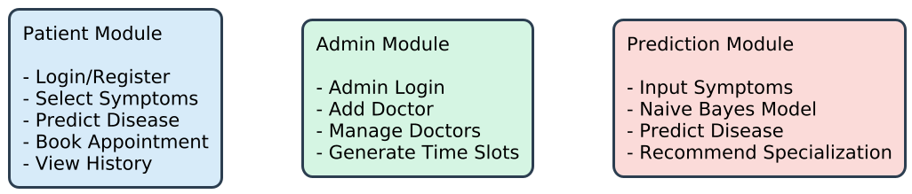
Module-wise Explanation

Slide 9
Dataset Description
Dataset Type
Structured, symptom-based medical dataset used for multi-class disease classification.
Dataset Structure
Column Name | Description
Disease | Target variable (Predicted output)
Specialization | Type of doctor required
Symptom1–Symptom5 | Symptoms associated with the disease
Key Characteristics
Multi-class classification dataset
Each disease linked with:
5 symptoms
1 doctor specialization
Supports both prediction + recommendation

Slide 10
Methodology
To identify the best performing algorithm, four classification models were trained and evaluated:
1). Decision Tree
2). Random Forest
3). Naive Bayes
4). Support Vector Machine (SVM)
Evaluation Metrics Used:
Accuracy
Stability (Standard Deviation of Accuracy)
The model with highest accuracy and lowest variance was selected.

Slide 11
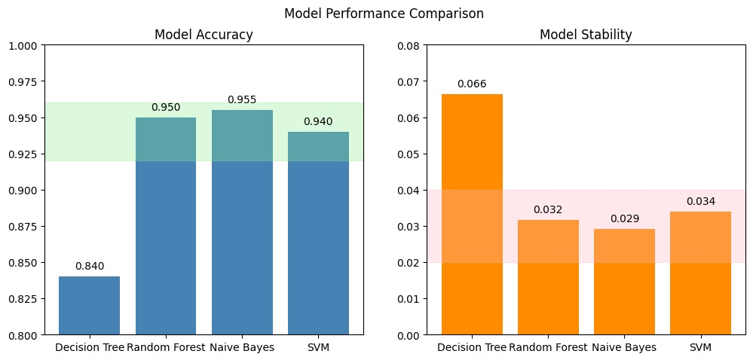
Model Performance Comparison

Slide 12
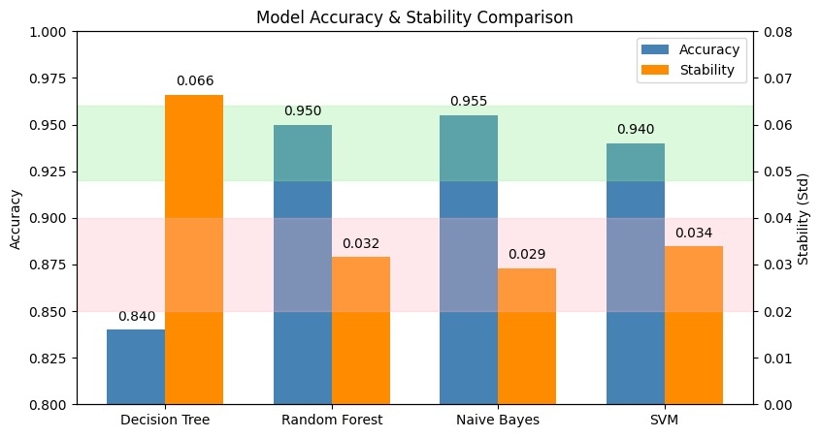
Model Performance Comparison
Final Model Selected: Naive Bayes
Reason for Selection:
Highest accuracy (95.5%)
Lowest variance (0.029)

Slide 13
Model Comparison
Model | Accuracy | Stability (Std Dev) | Why It Did Not Perform Best
Decision Tree | 84.0% | 0.066 | It overfits on small datasets and is sensitive to small changes in data, which reduces overall reliability.
Random Forest | 95.0% | 0.032 | More complex model; requires larger dataset for optimal learning; slightly higher variance
SVM | 94.0% | 0.034 | works better for high-dimensional numeric data
Naïve Bayes | 95.5% | 0.029 | —

Slide 14
System Implementation
The system is implemented using a full-stack architecture integrating:
Frontend (UI)
Backend (Spring Boot)
Database (MySQL)
Machine Learning Model (Naive Bayes)
Backend Implementation
Developed using Spring Boot (Java 17)
Follows MVC Architecture:
Controller Layer → Handles requests
Service Layer → Business logic
Repository Layer → Database operations

Slide 15
System Implementation
Frontend Implementation
Built using:
HTML, CSS, Bootstrap
Thymeleaf (dynamic rendering)
Provides:
User Dashboard
Disease Prediction UI
Appointment Booking Interface
Database Implementation
MySQL relational database
Managed using Spring Data JPA & Hibernate
Stores:
Users
Doctors
Appointments
Time Slots

Slide 16
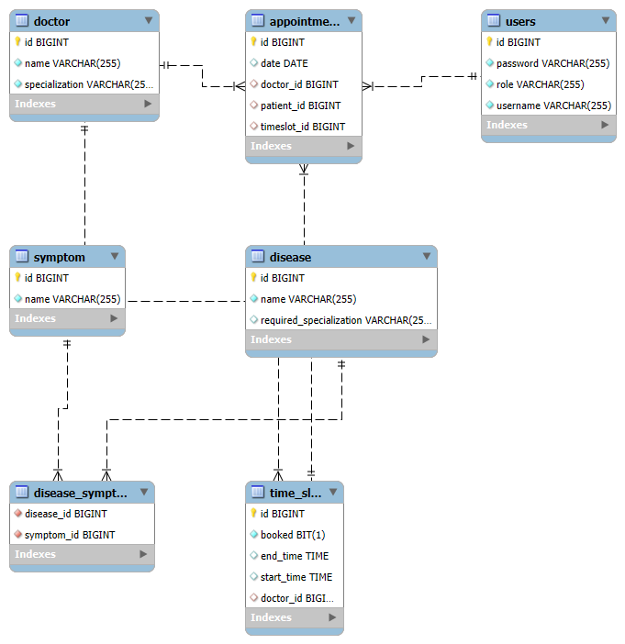
Database Design & Relationships

Slide 17
Database Design & Relationships
Main Tables
Users → Stores login & roles
Doctor → Doctor details & specialization
Appointment → Booking records
Time Slot → Doctor availability
Disease → Disease & specialization mapping
Symptom → List of symptoms
Relationships
One-to-Many (1:M)
Doctor → Time Slot One doctor has multiple time slots
User (Patient) → Appointment One patient can book multiple appointments
Many-to-Many (M:M)
Disease ↔ Symptom One disease has multiple symptoms

Slide 18
Database & ORM Layer
MySQL
Relational database
Stores users, doctors , appointments
Maintains foreign key relationships
Spring Data JPA
Repository abstraction layer
Provides CRUD operations
Reduces manual SQL queries
Hibernate (ORM)
Maps Java objects to database tables
Generates SQL queries automatically
Manages relationships & transactions

Slide 19
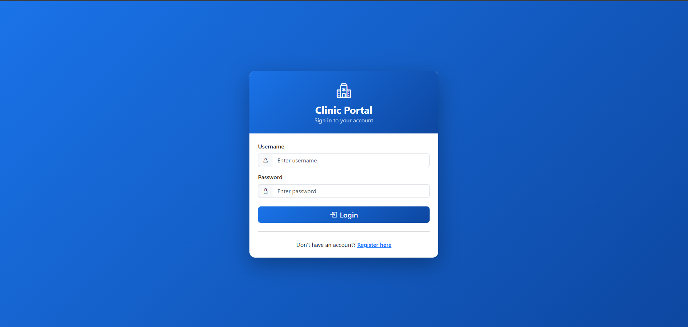
System User Interface

Slide 20
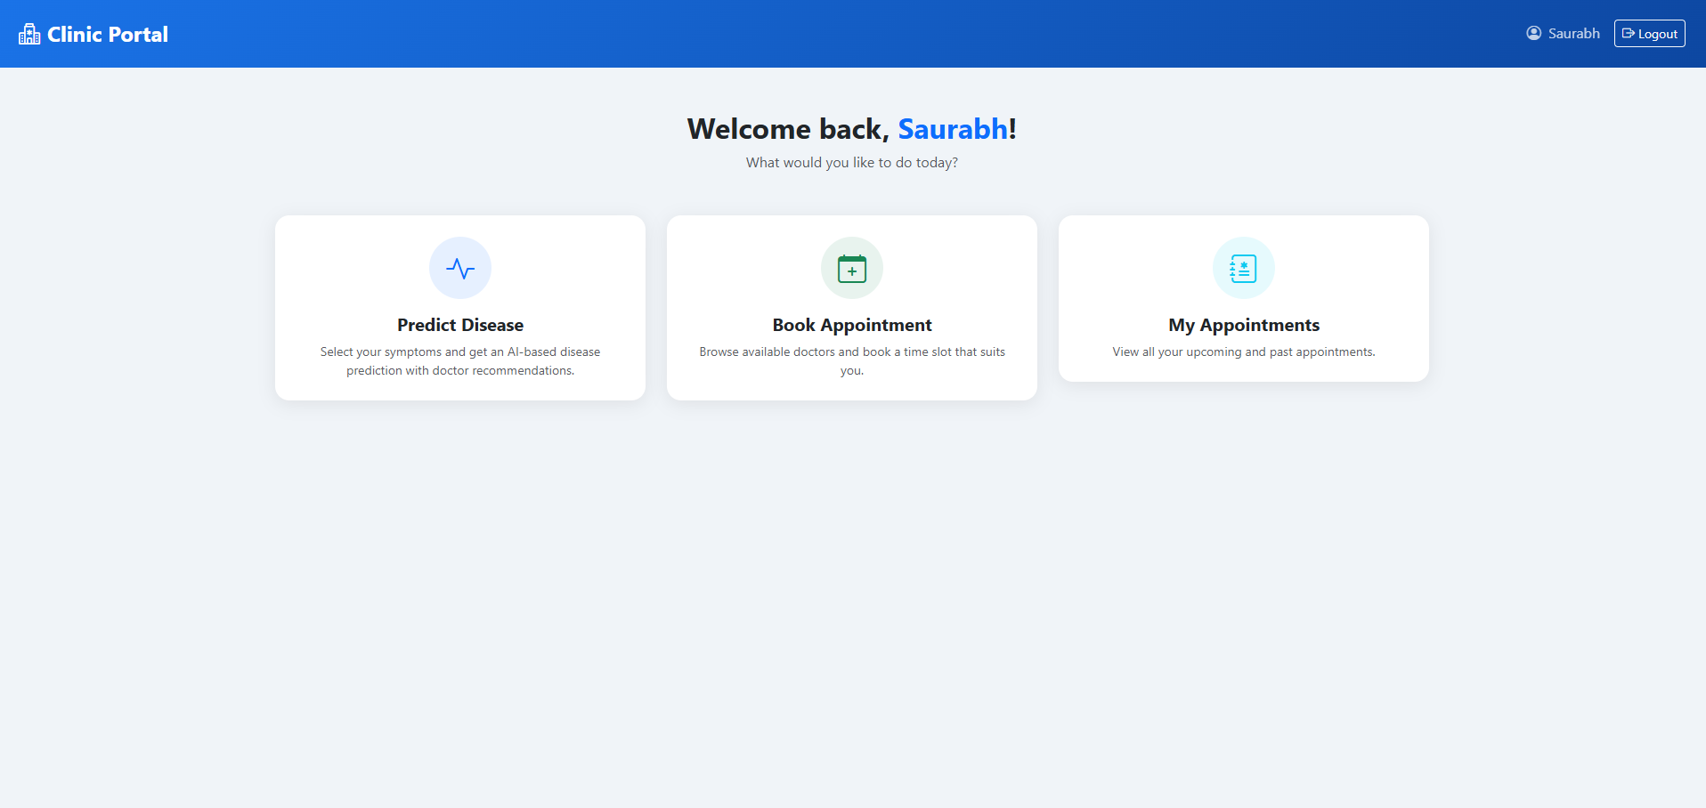
User Dashboard

Slide 21
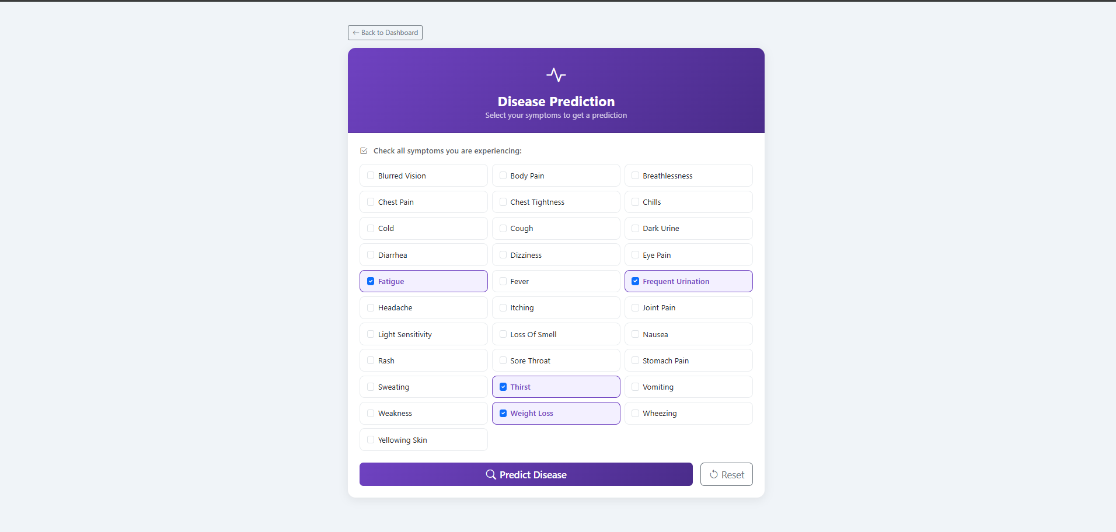
Disease Prediction Input

Slide 22
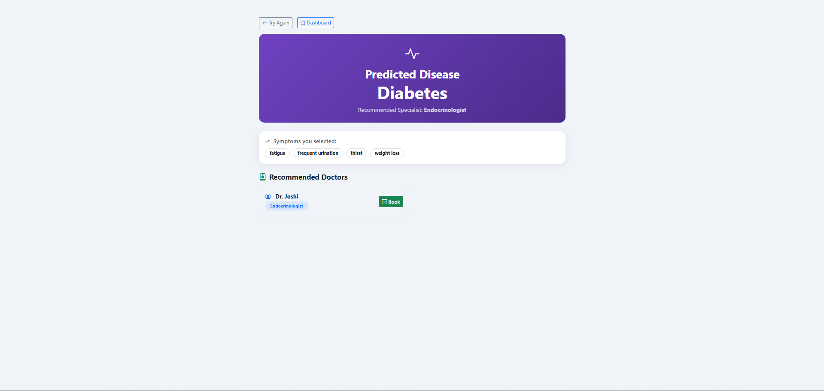
Disease Prediction Output

Slide 23
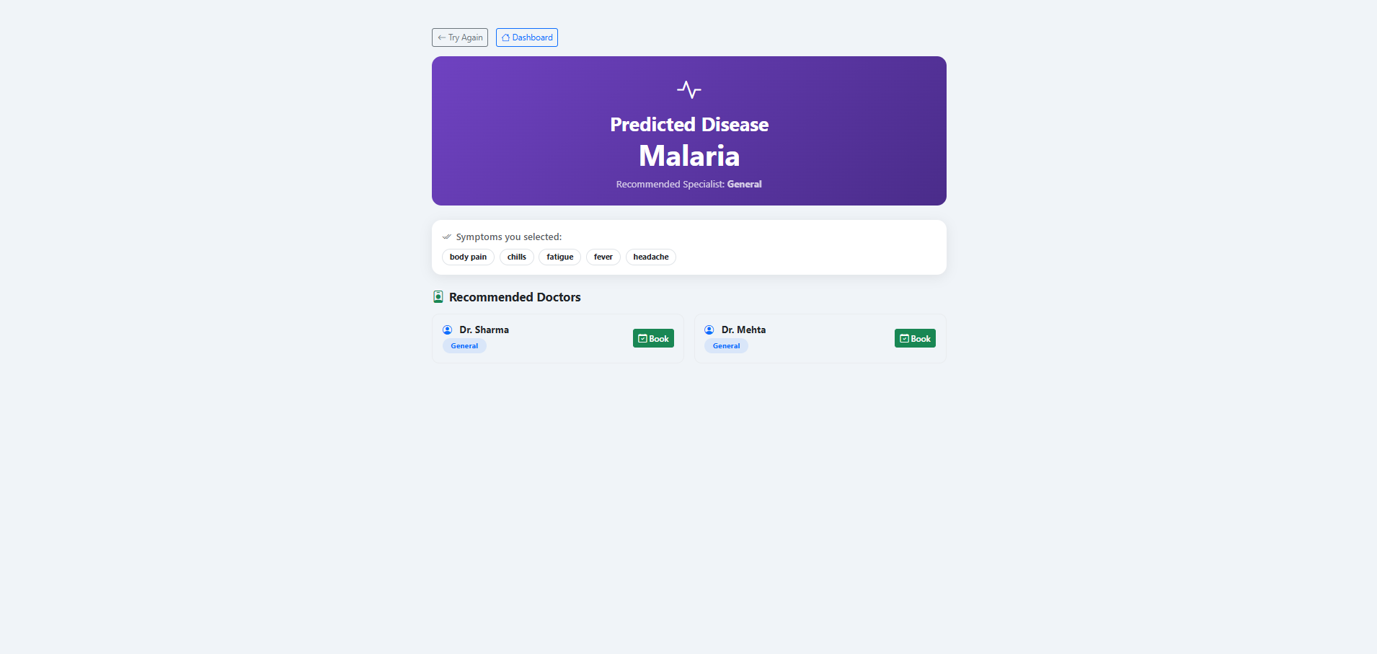
Disease Prediction Output

Slide 24
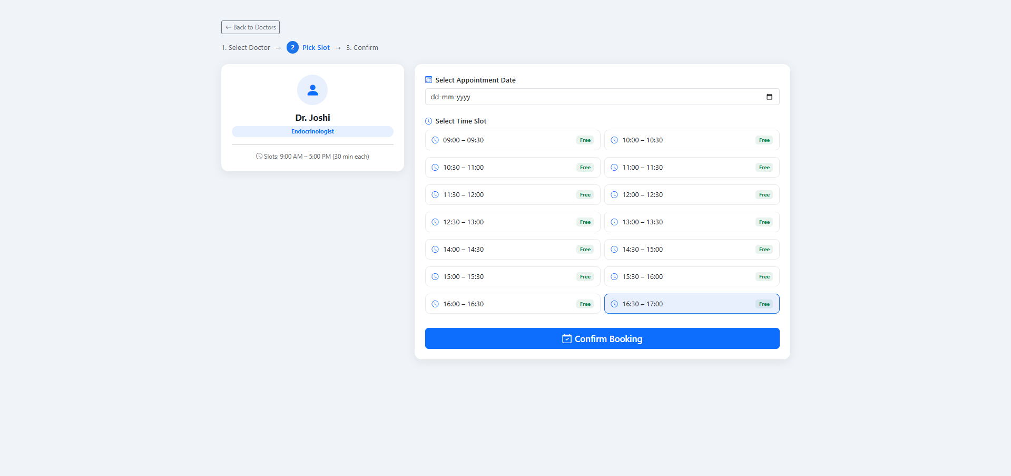
Appointment Slot Booking

Slide 25
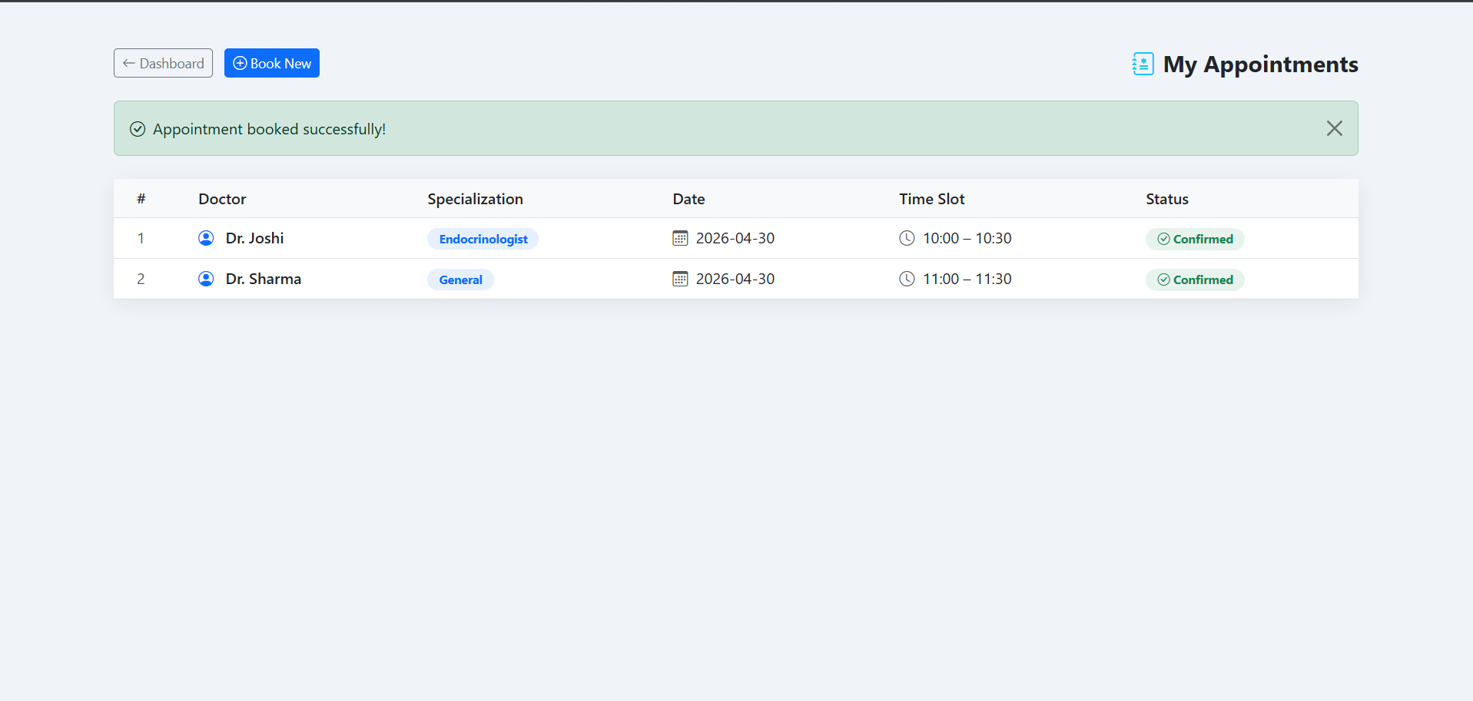
Appointment Confirmation / My Appointments

Slide 26
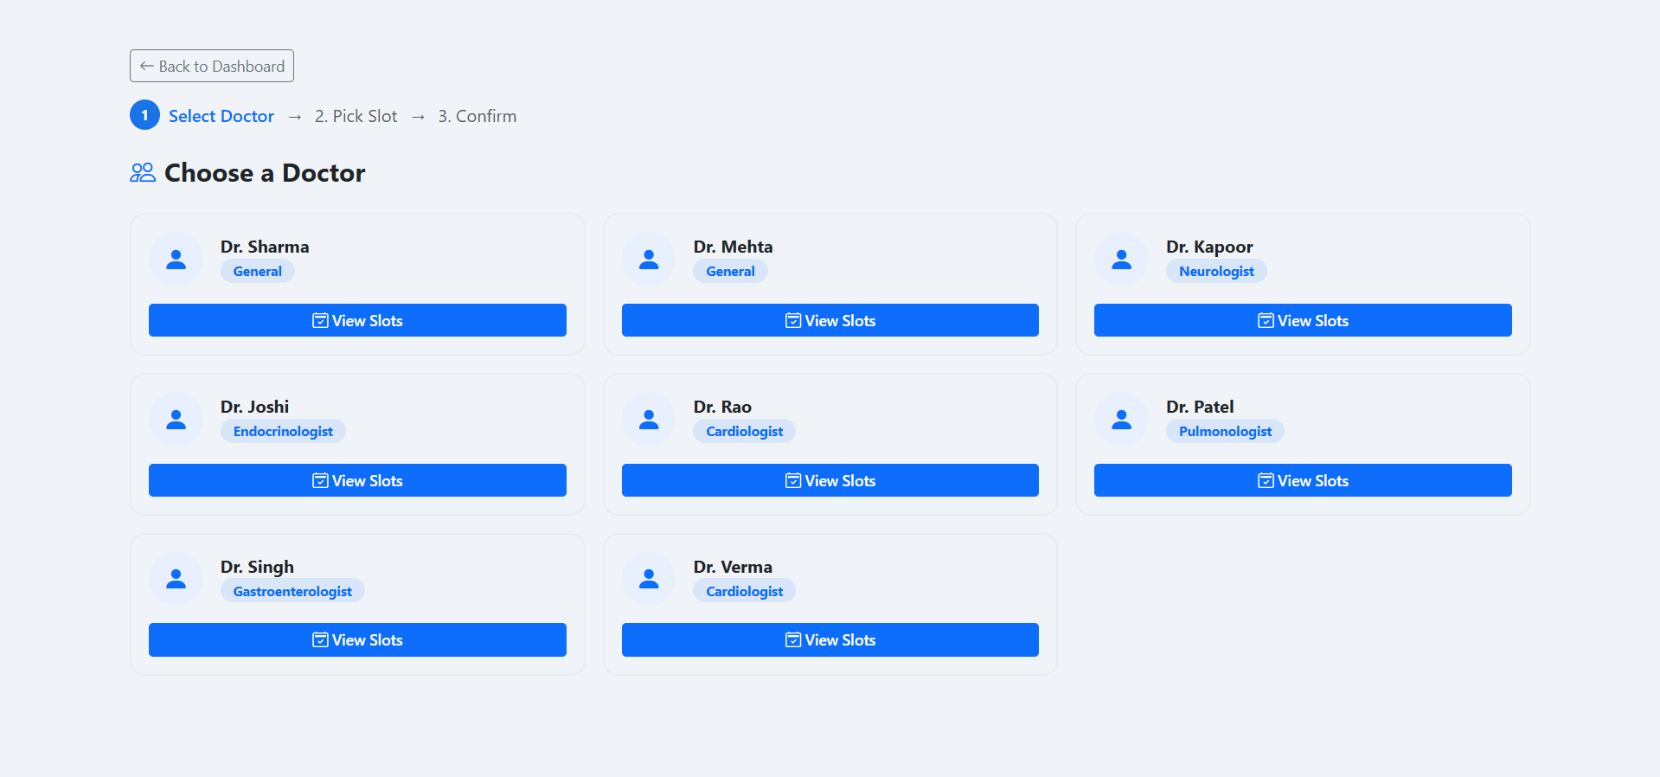
Doctor Selection Page

Slide 27
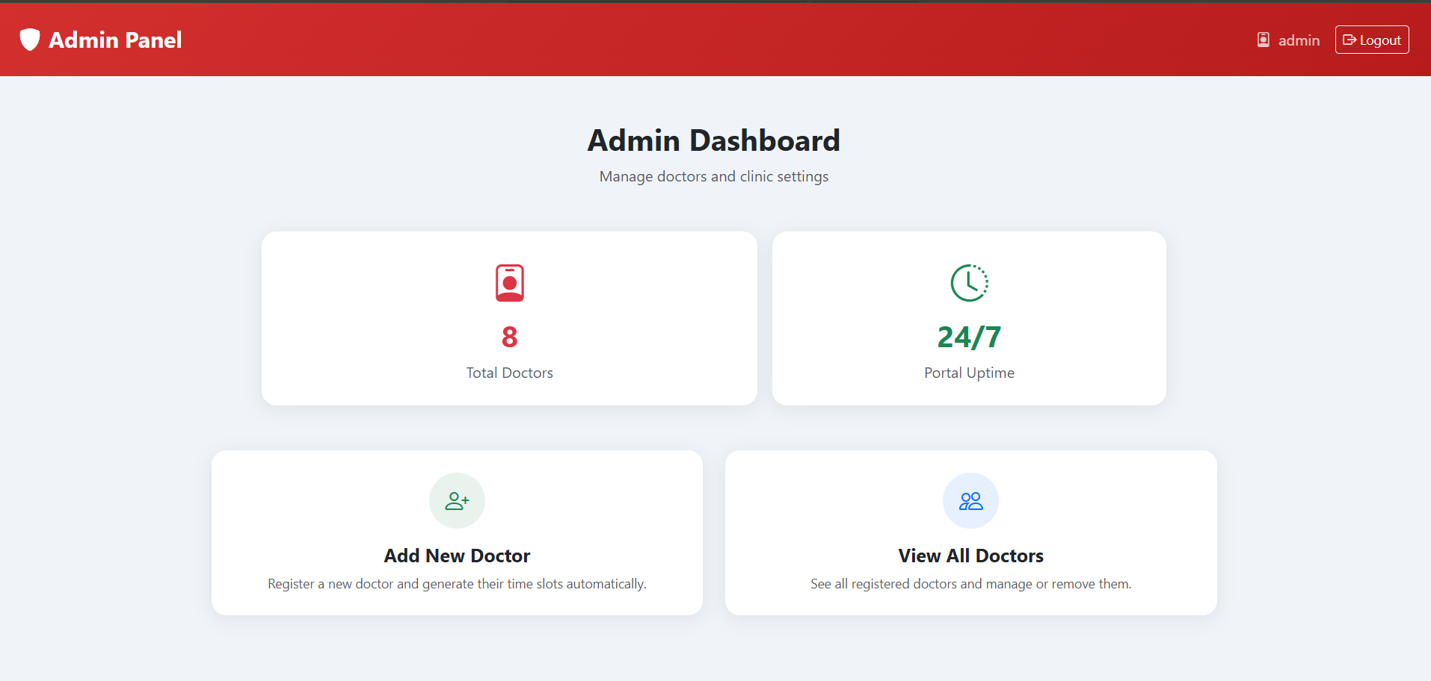
Admin Dashboard

Slide 28
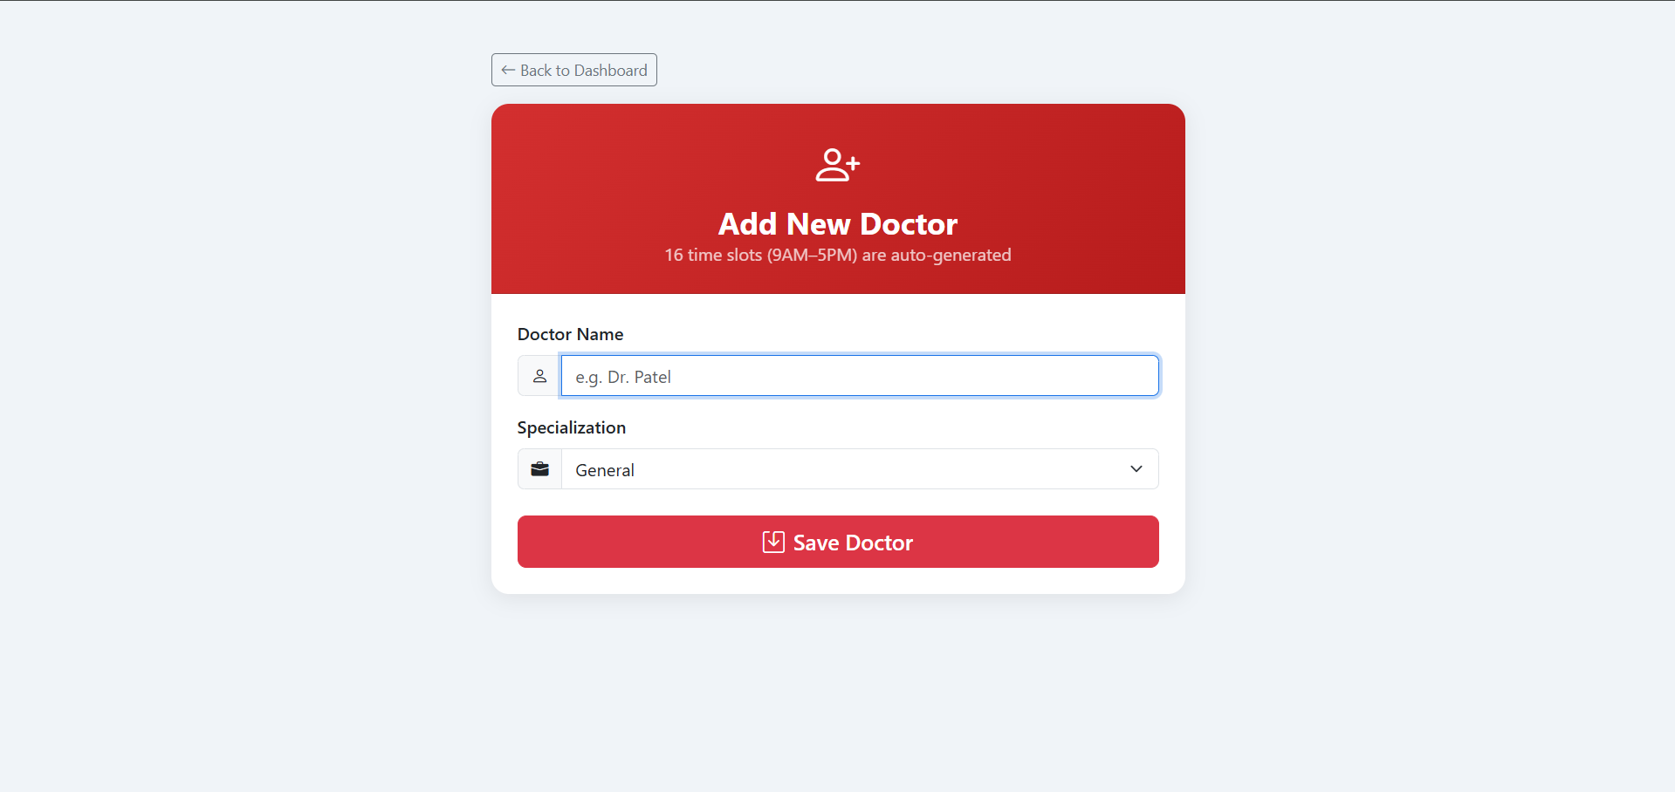
Add Doctor Page

Slide 29
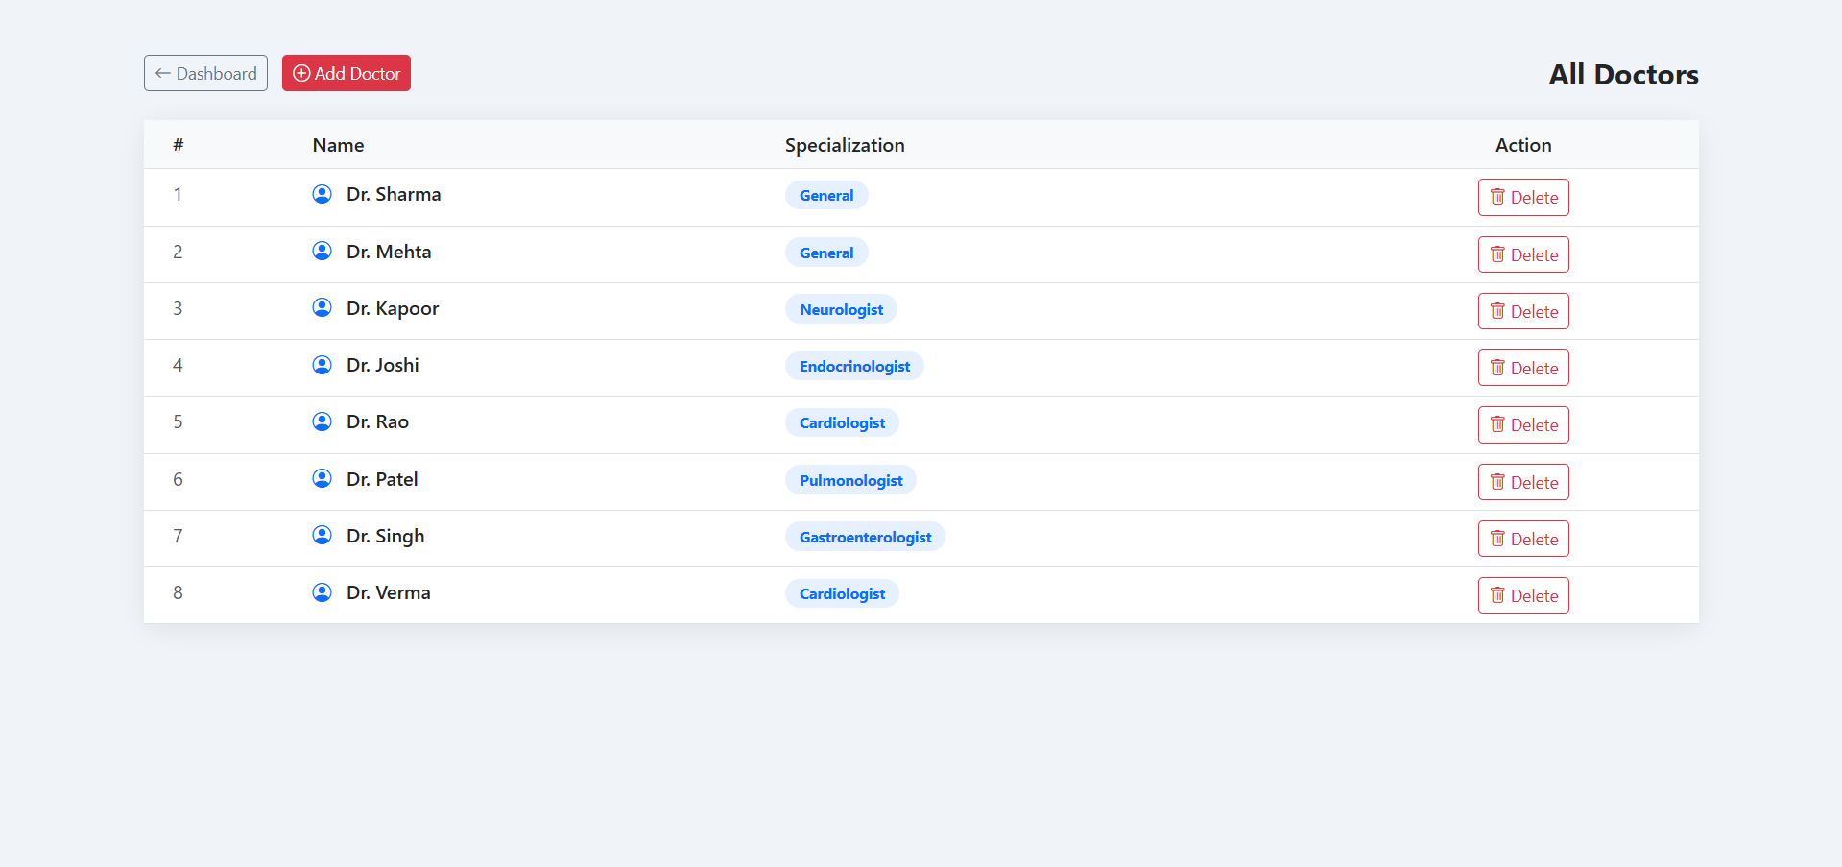
View Doctors Page

Slide 30
Need for Cloud Deployment
Local System | Cloud Deployment
Only works on localhost | Accessible from anywhere
Single user access | Multiple user access
Stops when PC is off | Available 24×7
Data stored locally | Data stored in cloud
Hard to demonstrate | Easy to share and test
Limited resources | Better scalability
Why Cloud Deployment?
Global Accessibility
24×7 Availability
Better Reliability
Easy Demonstration
Real-World Deployment

Slide 31
Cloud Platform Comparison
Platform | Free Tier | Database
Render | Yes | PostgreSQL
Railway | Limited | MySQL / PostgreSQL
AWS | Paid | RDS
Azure | Paid | Azure SQL
Google Cloud | Trial | Cloud SQL
Heroku | Paid | PostgreSQL

Slide 32
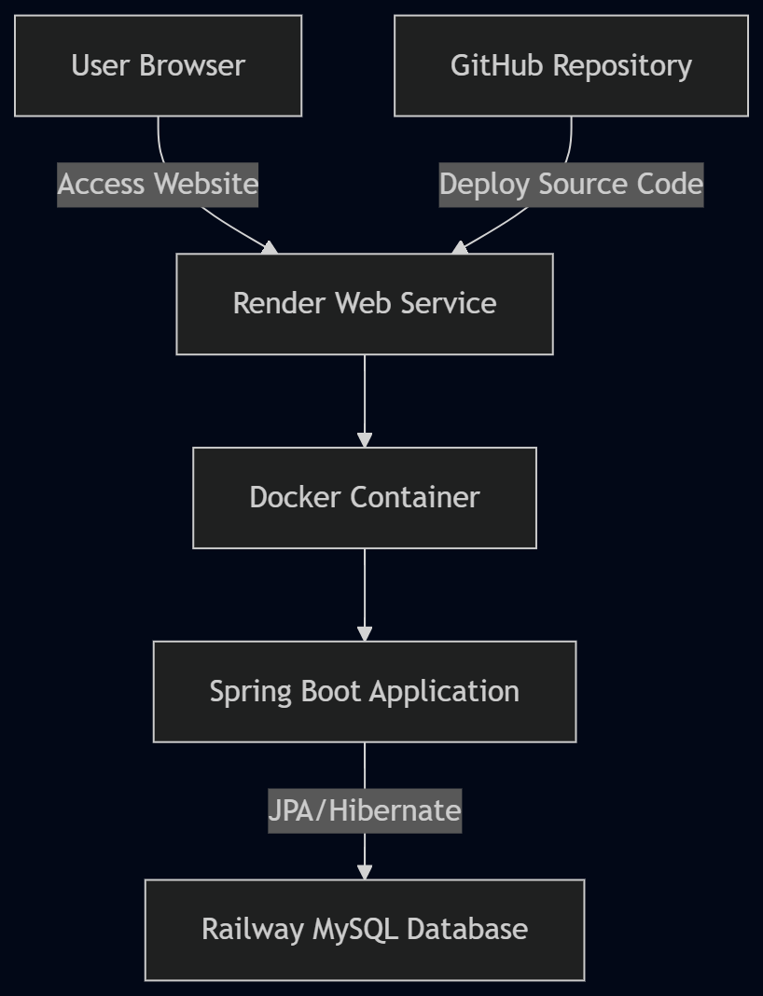
Cloud Deployment Architecture
• Application deployed on Render Cloud
• Database hosted on Railway MySQL
• Docker used for containerization
• GitHub used for version control and deployment
• Environment variables used for secure database configuration
• Publicly accessible web application
Live Deployment URL:
https://ai-powered-clinic-management.onrender.com

Slide 33
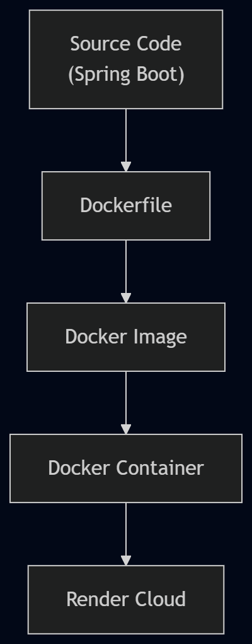
Docker-Based Application Packaging
Why Docker?
Java Spring Boot applications are not directly supported on Render Free Tier.
Docker was used to package the complete application.
Docker includes:
Java Runtime
Spring Boot Application
Required Dependencies
It ensures the application runs the same way on every machine.
Makes deployment simple and reliable.

Slide 34
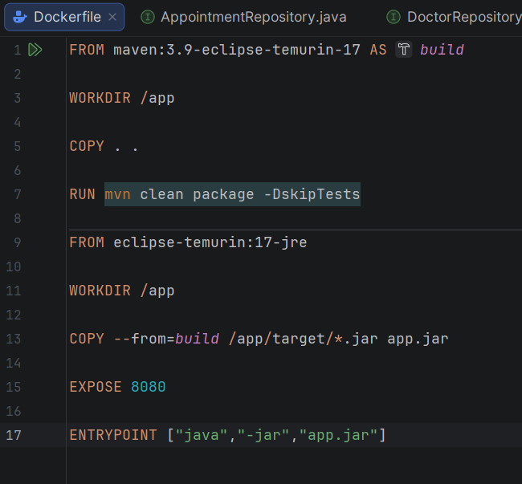
Dockerfile
Key Functions
Builds Spring Boot application using Maven
Creates executable JAR file
Packages application into Docker container
Exposes port 8080
Starts application automatically on deployment

Slide 35
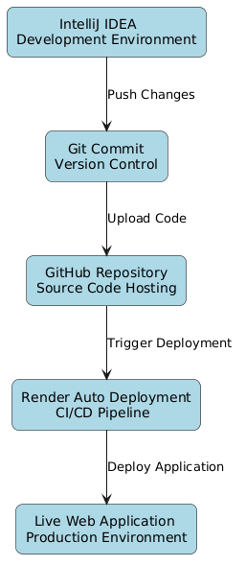
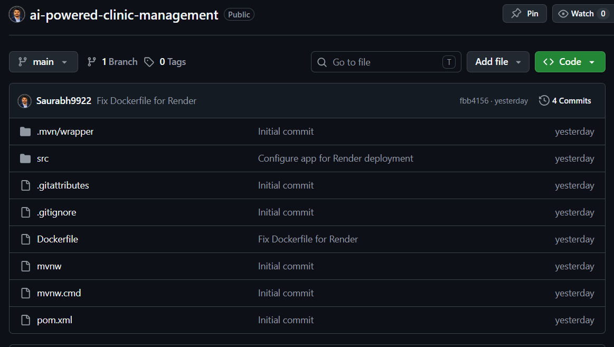
Version Control Management
Project is developed in IntelliJ IDEA.
Changes were committed using Git.
Source code is pushed to GitHub repository.
Render automatically fetched the latest code from GitHub.
Every new push triggers automatic deployment.

Slide 36
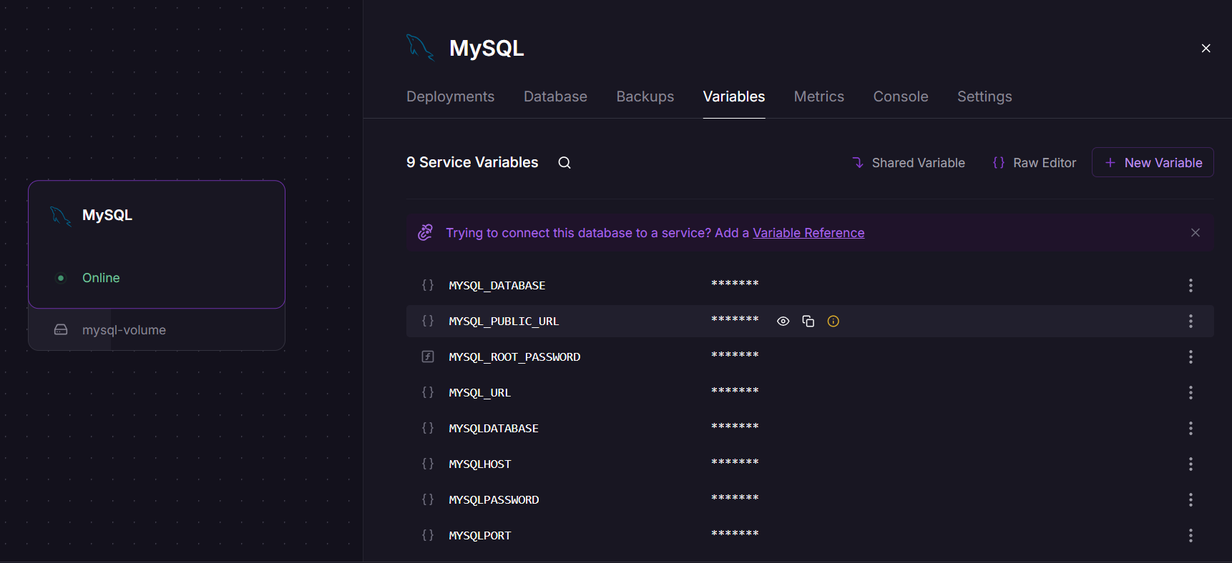
Cloud Database Deployment
Railway MySQL Database provides:
Managed cloud database service
Accessible from anywhere through the internet
Secure storage of database credentials
Easy integration with Spring Boot applications

Slide 37
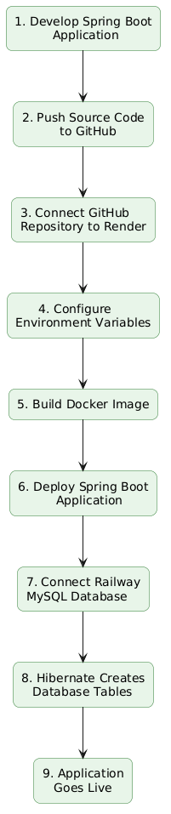
Application Deployment on Render
Key Deployment Activities
GitHub Integration
Source code hosted on GitHub
Connected GitHub repository with Render
Docker Deployment
Docker used for application packaging
Render automatically builds and deploys the application
Database Connection
Railway MySQL used as cloud database
Credentials managed through environment variables
Application Startup
Spring Boot starts automatically
Hibernate creates tables and initializes sample data

Slide 38
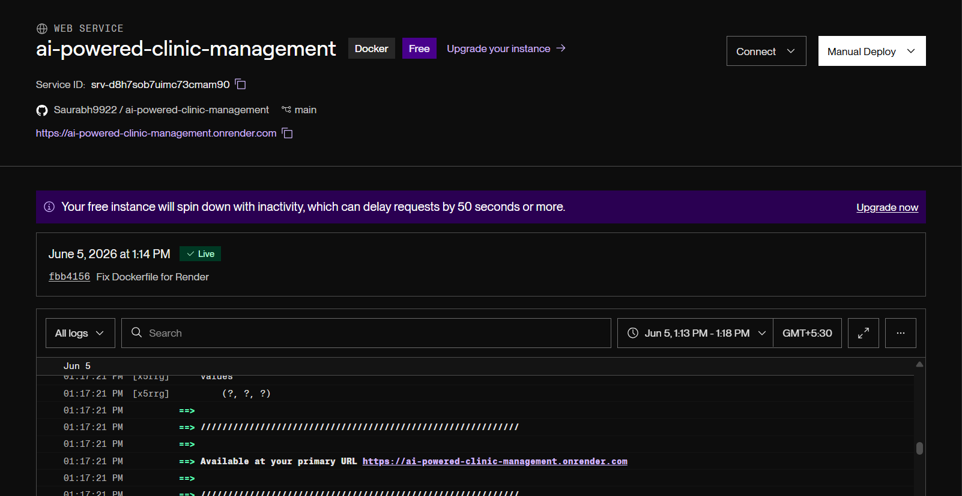
Deployment Success

Slide 39
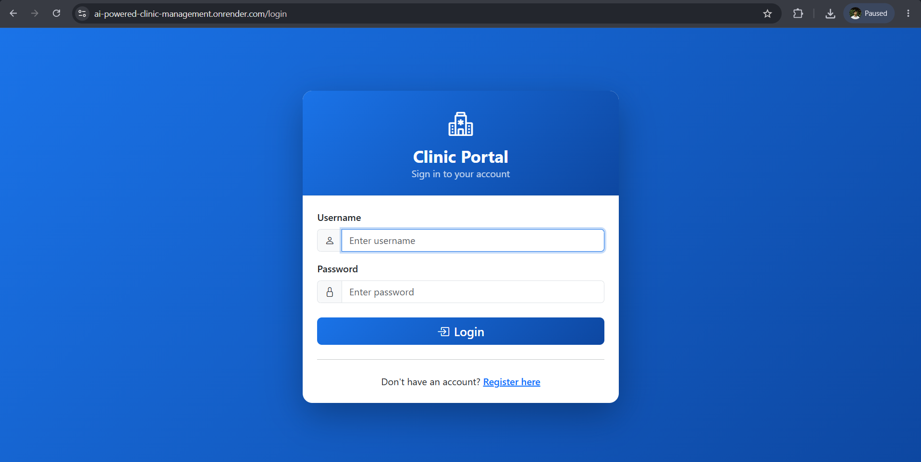
Live

Slide 40
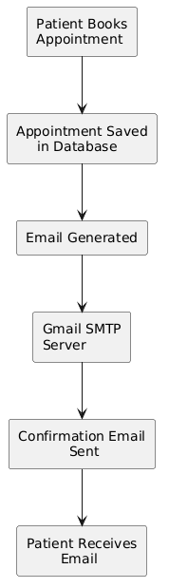
Email Notification Feature
Purpose:
• Automatically notify patients after appointment booking
Key Features:
• Instant appointment confirmation
• Professional email format
• Includes doctor and appointment details
• Improves patient communication
• Reduces chances of missed appointments
Technology Used:
• Spring Boot Mail
• Gmail SMTP
• JavaMailSender

Slide 41
Email Notification Implementation
Implementation Steps
1. Added Spring Boot Mail Dependency
2. Added Email Field in User Entity
3. Updated Registration Form
4. Updated Controller
5. Configured Gmail SMTP
6. Generated Google App Password
7. Created EmailService
8. Integrated EmailService with AppointmentService
9. Generated Professional Email Template
10. Automated Email Sending

Slide 42
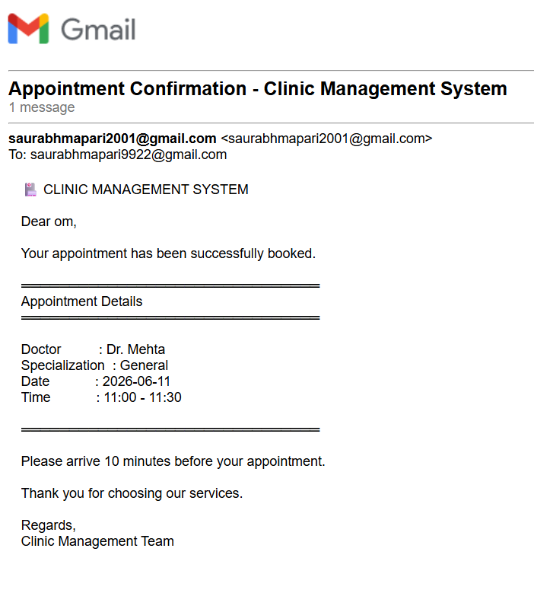
Appointment Confirmation Email

Slide 43
Project Achievements
✔ Disease Prediction using Naive Bayes ✔ Online Appointment Booking ✔ Role-Based Authentication ✔ Cloud Deployment on Render ✔ Railway MySQL Integration ✔ Docker Containerization ✔ Email Notification System

Slide 44
Future Scope
1).Real-Time Clinical Dataset Integration
Train the model using real hospital patient records
Improve prediction accuracy and reliability
2).Cloud Deployment
Migration to AWS/Azure/GCP
Kubernetes-based deployment
3).Online Payment Integration
Add secure payment gateway for appointment booking
Enable digital billing and transaction records
4).Telemedicine Integration
Video consultation feature
Online prescription management

Slide 45
Conclusion
The Clinic Management System integrates machine learning and web technologies to improve healthcare services. It enables early disease prediction and provides suitable doctor recommendations. The system also offers efficient online appointment booking with slot management. Overall, it delivers a smart, user-friendly, and time-saving solution for clinic management.

Slide 46
References
A. Satija, P. Pahuja, D. Singh, and A. Hussain, Prediction in Medicine: The Impact of Machine Learning on Healthcare, Elsevier, Oct. 2024.
P. Jyothi, A. Lokesh Kumar, and D. Dakshayani, “Disease Prediction Using Naïve Bayes, Random Forest, Decision Tree and KNN Algorithms,” i-Manager’s Journal on Computer Science, vol. 11, no. 4, pp. 12–20, Jan. 2024.
R. Shukla, “Disease Prediction System Using Support Vector Machine and Random Forest Classifiers,” International Journal of Innovative Science and Research Technology, Mar. 2023.
ClinicCare Manager: An Efficient Electronic Health Record (EHR) and Healthcare Management System Using Spring Boot and React, Jan. 2026.
T. Mendes, “Integration of IoT Health Systems and Hospital Management Using Spring Boot and API Frameworks,” Proc. Int. Conf. on Artificial Intelligence and Engineering, 2025.
S. Hossain, M. Rahman, and T. Islam, “Machine Learning Approaches for Multi-Disease Prediction Using Ensemble Techniques,” IEEE Access, vol. 12, pp. 45890–45905, 2024.
Y. Chen, L. Zhang, and H. Li, “Comparative Analysis of Supervised Learning Algorithms for Healthcare Diagnosis,” IEEE Trans. on Computational Biology and Bioinformatics, vol. 21, no. 3, pp. 1456–1468, 2024.
M. K. Sharma and R. Gupta, “Design and Implementation of a Secure Hospital Management System Using Spring Boot and Microservices,” in Proc. IEEE Int. Conf. on Computing, Communication and Intelligent Systems (ICCCIS), 2023.

